Slide 1
"Welcome”!
😍

Slide 2

08
Imperial College of Engineering
(RU Affiliated)
BSC Engineering 1st year 1st semester Examination ,2024
Course code: CSE1111
Course title: Introduction to Computer System
Presented by:-
Date: 12 /11 /2024
01
MD Rashidul Islam Zidan & Mst Ruhani Ishika
Roll:23109 & 23110
Session:2023-24

Slide 3

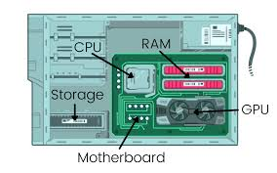
08
02
TITLE
“CPU and Motherboard”
“The Heart of Your Computer”
Fig:01

Slide 4
03
“ Overview”
Introduction.
Motivation.
Describe CPU.
Describe Motherboard.
Conclusion.

Slide 5
04
“MOTIVATION”
This presentation is motivated by the need to demystify these critical components and explore their roles in the computing ecosystem.
Understanding CPU and Motherboard.
Impact on Performance.
Upgrade and Compatibility.
Empowering Informed Choices.

Slide 6
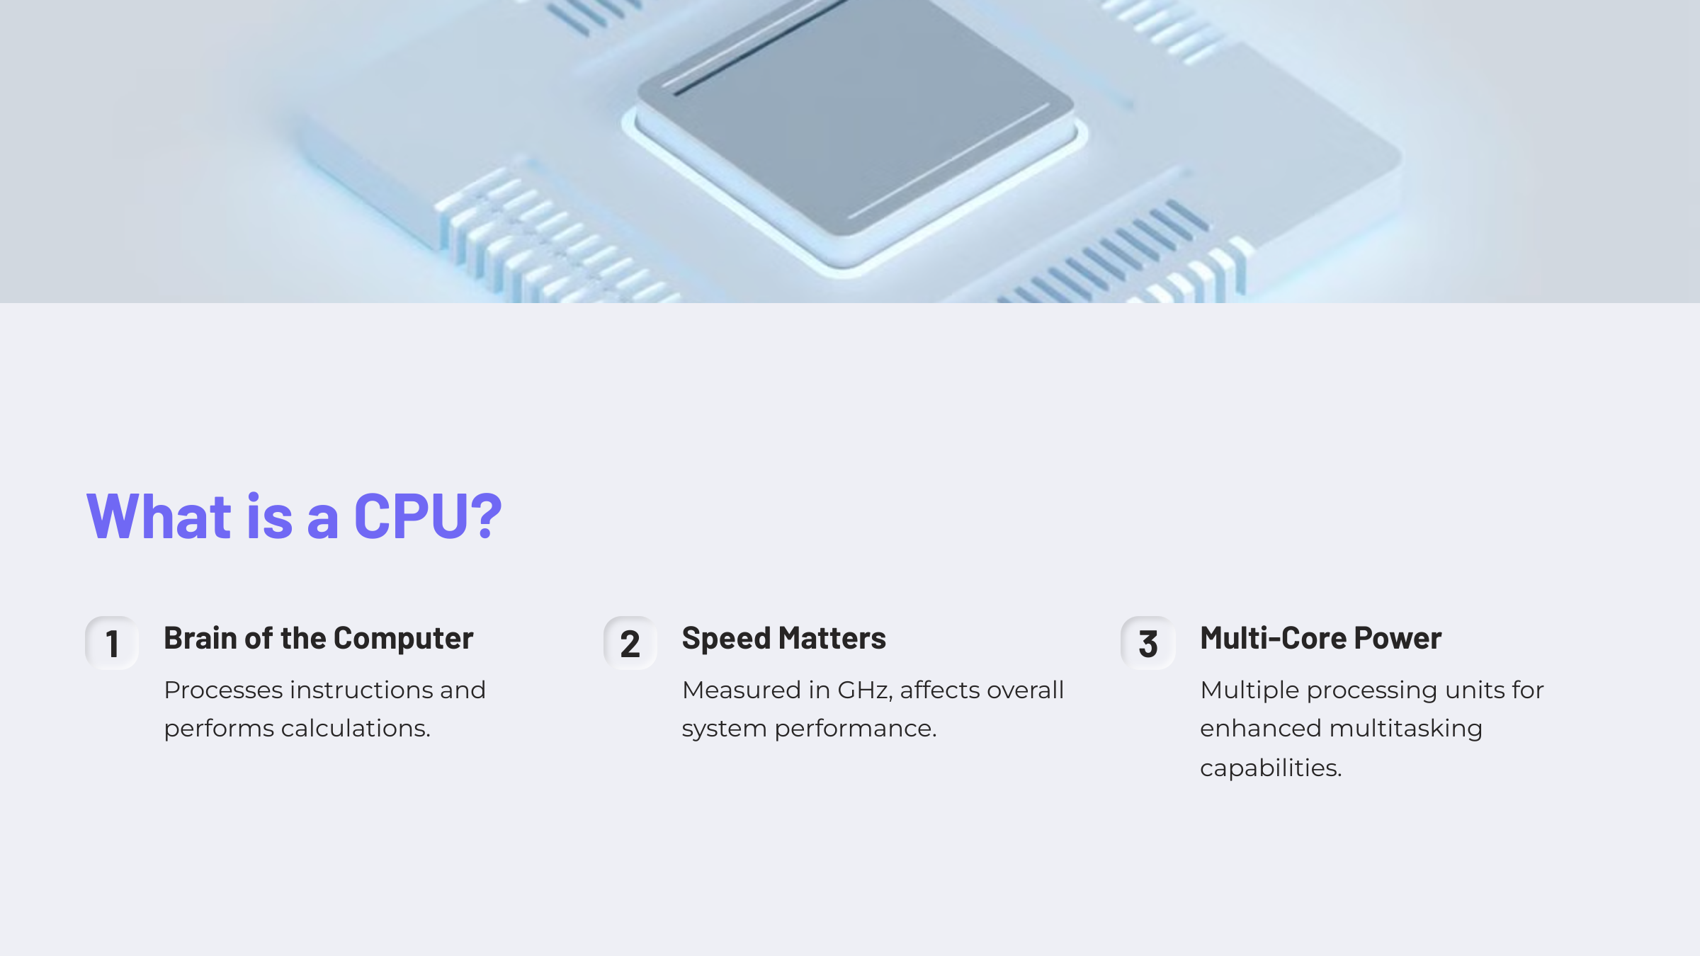
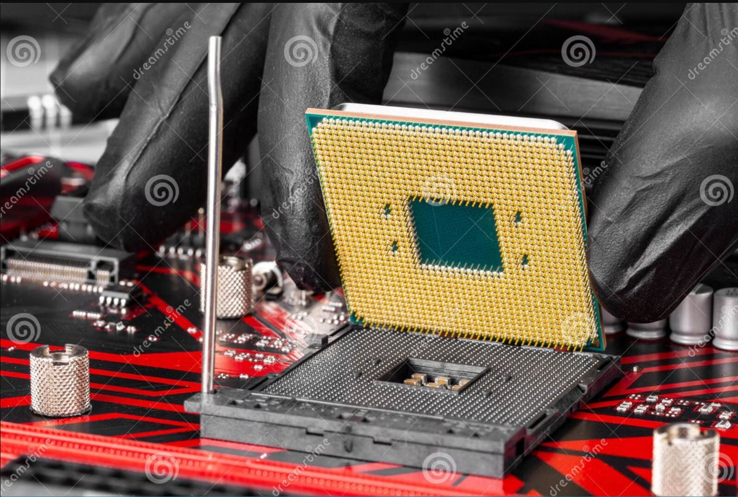
05
Fig:02

Slide 7
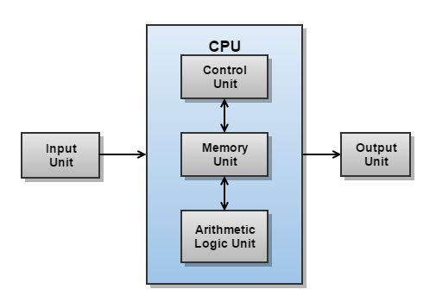
08
06
Components of CPU:-
The main components of a CPU are:
Control Unit: Directs operations.
ALU: Handles calculations.
Registers: Store data temporarily.
Cache: Speeds up data access.
Busses: Transfer data.
Clock: Sets processing speed.
Thease parts work together to process tasks quickly.
Fig:03

Slide 8

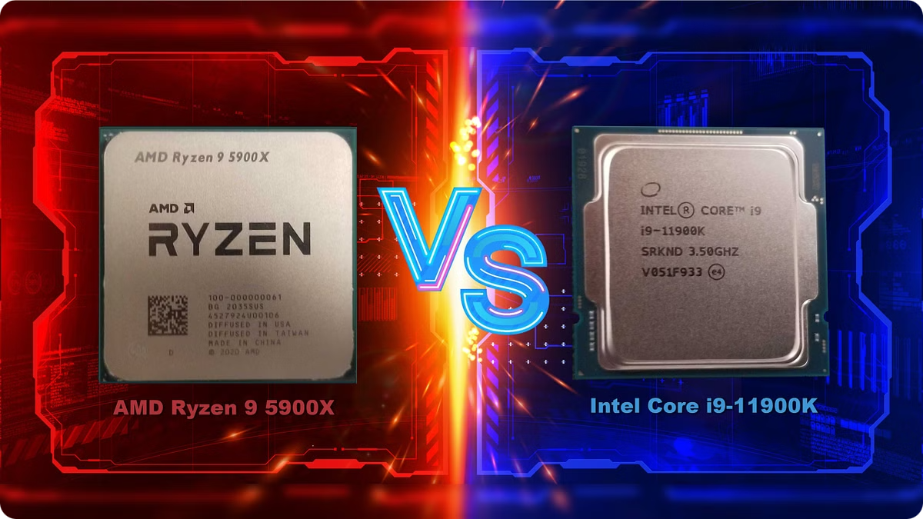
08
Popular CPUs in the Market
07
Model
Cores
Clock Speed
Intel Core i9-13900K
24
5.8 GHz
AMD Ryzen 9 7950X
16
5.7 GHz
Fig:04

Slide 9
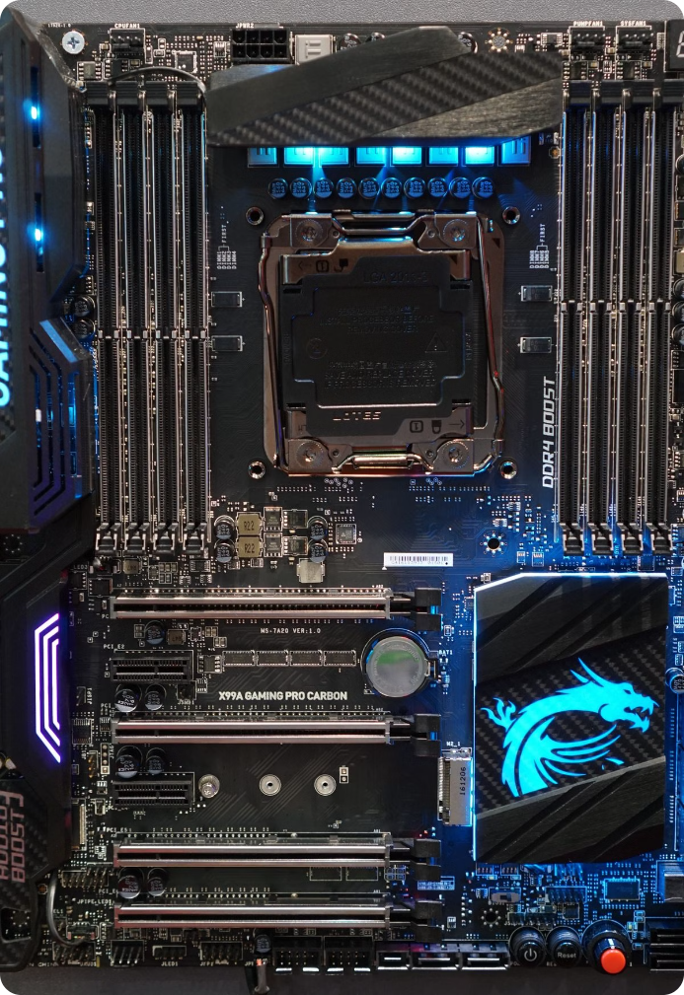

08
8
What is Motherboard?
Function
Compatibility
Connects CPU, RAM, storage, and peripherals.
Determines component compatibility (CPU socket, RAM type).
Form Factors
Popular sizes: ATX, Micro-ATX, Mini-ITX.
Fig:05

Slide 10
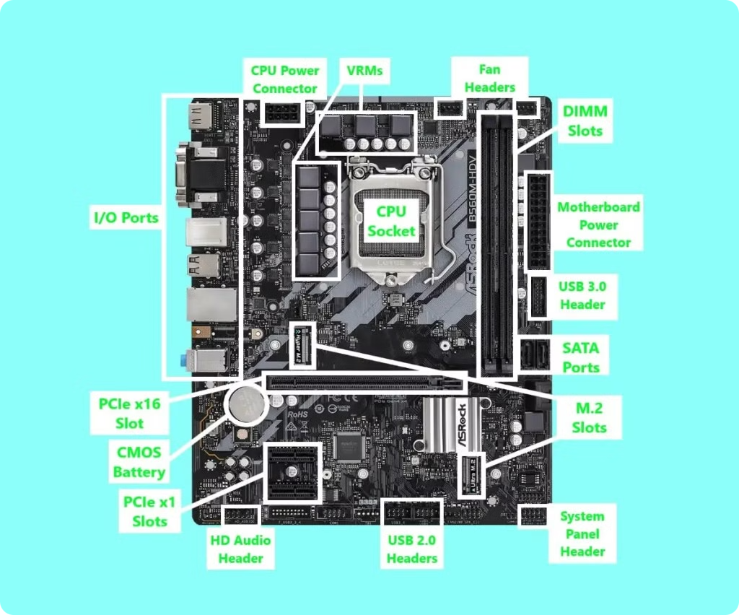

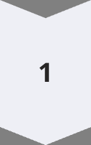
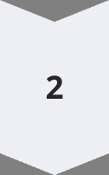
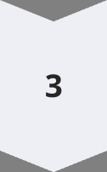
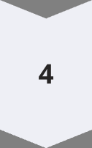
08
9
Key Components of a Motherboard
CPU Socket
Houses and connects the CPU.
RAM Slots
Accommodate memory modules for system RAM.
PCIe Slots
Expand functionality with graphics cards and peripherals.
Storage Ports
Connect SSDs and HDDs via SATA/M.2.
Fig:06

Slide 11
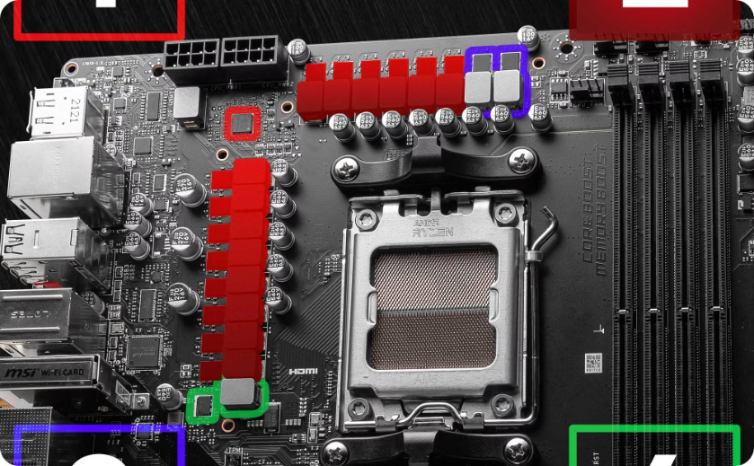
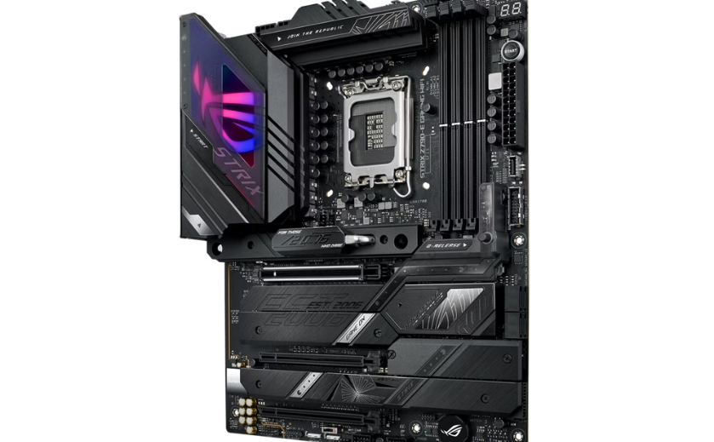
08
10
Popular Motherboards
Fig:08
Fig:07
ASUS ROG Strix Z790-E
MSI MAG B650 TOMAHAWK
High-end Intel gaming motherboard with PCIe 5.0.
AMD Ryzen compatible with PCIe 4.0 support.

Slide 12
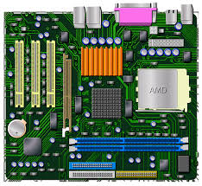

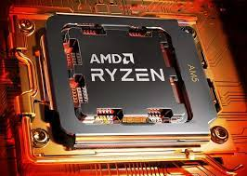



Summary
08
11
Fig:09
CPU
Motherboard
Compatibility
Processes tasks, runs applications.
Connects and powers all system components.
Crucial for optimal system performance.

Slide 13
Thank you for being here….

